Slide 1
Paired Reading Monday 28th February 2022 – Friday 8th April 2022
Paired
Reading

Slide 2
Importance of Reading
“Reading is the key that opens the door
to the rest of the curriculum; lack of reading
ability affects progress in all subject areas”.
(T Worthington 1998)

Slide 3
What is Paired Reading?
Paired
Reading
- Six week programme
- Time
- Peaceful place
- ENJOY!

Slide 4
Why Paired Reading?
Tried and tested - improved reading and greater confidence
Personal and make their own choice
More interested in reading
Reading for enjoyment
Paired
Reading
Notes:
It boosts confidence, gives child one-to-one attention, encourages reading for meaning

Slide 5
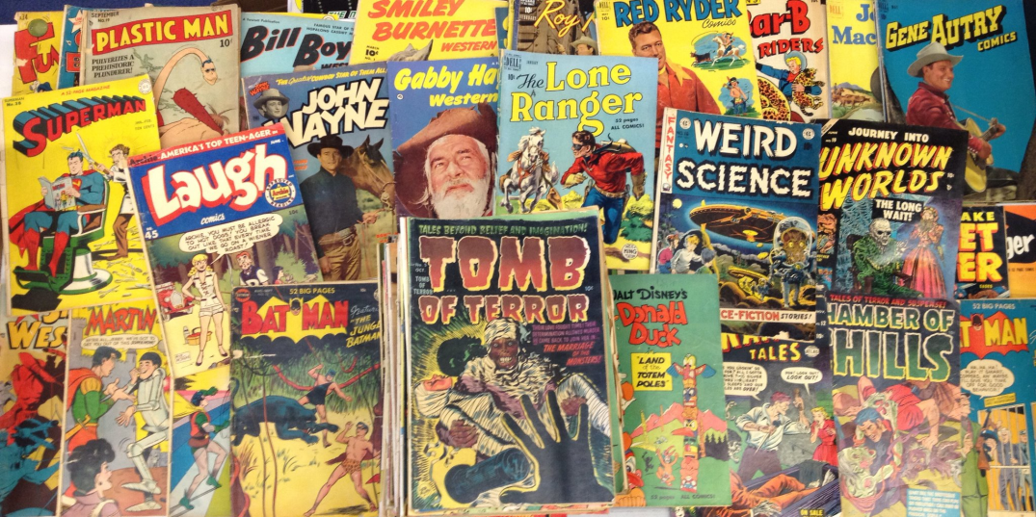
How do you do ‘Paired Reading’?
Paired
Reading

Slide 6
Choosing what to read
Read from a variety of genres - sci-fi, fiction,
non-fiction, newspaper articles, comics….
Paired
Reading

Slide 7
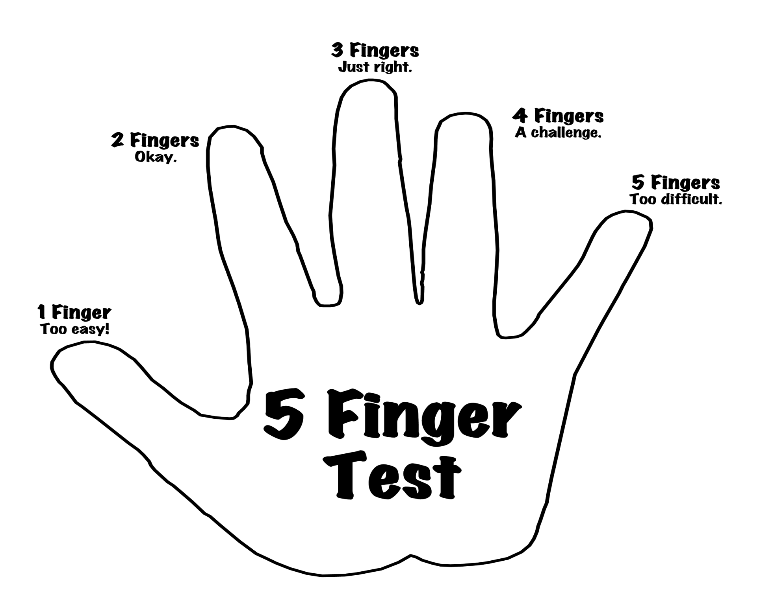
Paired
Reading

Slide 8
Before reading...
Paired
Reading
get comfortable
look at the cover
predict
talk about
new words

Slide 9
read with your child –
at the same pace
if mistakes made, allow 4 seconds for child to self correct
you and your child reading together
if not corrected, say word and
ask child to repeat correctly
Use praise
Ask questions and discuss
what you are reading

Slide 10
Child gives agreed signal. Praise for reading alone.
Paired
Reading
Child reads alone. Ask questions and discuss from time to time
when your child is reading alone
If mistake is made, give 4 seconds to correct.
If not corrected, you say word and ask your child to repeat correctly.
read together again until
your child signals to read alone.

Slide 11
During reading...
Paired
Reading
ask questions
discuss what they know-link to what they know already or thought before
encourage your child to work out the meaning of new words

Slide 12
After reading...
ask questions
talk about what you have
read
evaluate your reading

Slide 13
Start and End of Programme
Pupils tested at the beginning of the programme and at the end
Improvement in reading ability expected
RESPONSIBILITY of parent to ensure that programme is adhered to

Slide 14
How much time should we spend reading?
Diary to be completed for each week with comments from parent and child
Complete for five days out of seven
Duration: approximately 15 mins (10 mins reading; 5 mins discussion)

Slide 15
FINALLY…
ENJOY the programme
Greater effort put into programme more benefit for both pupil and parent

